Slide 1
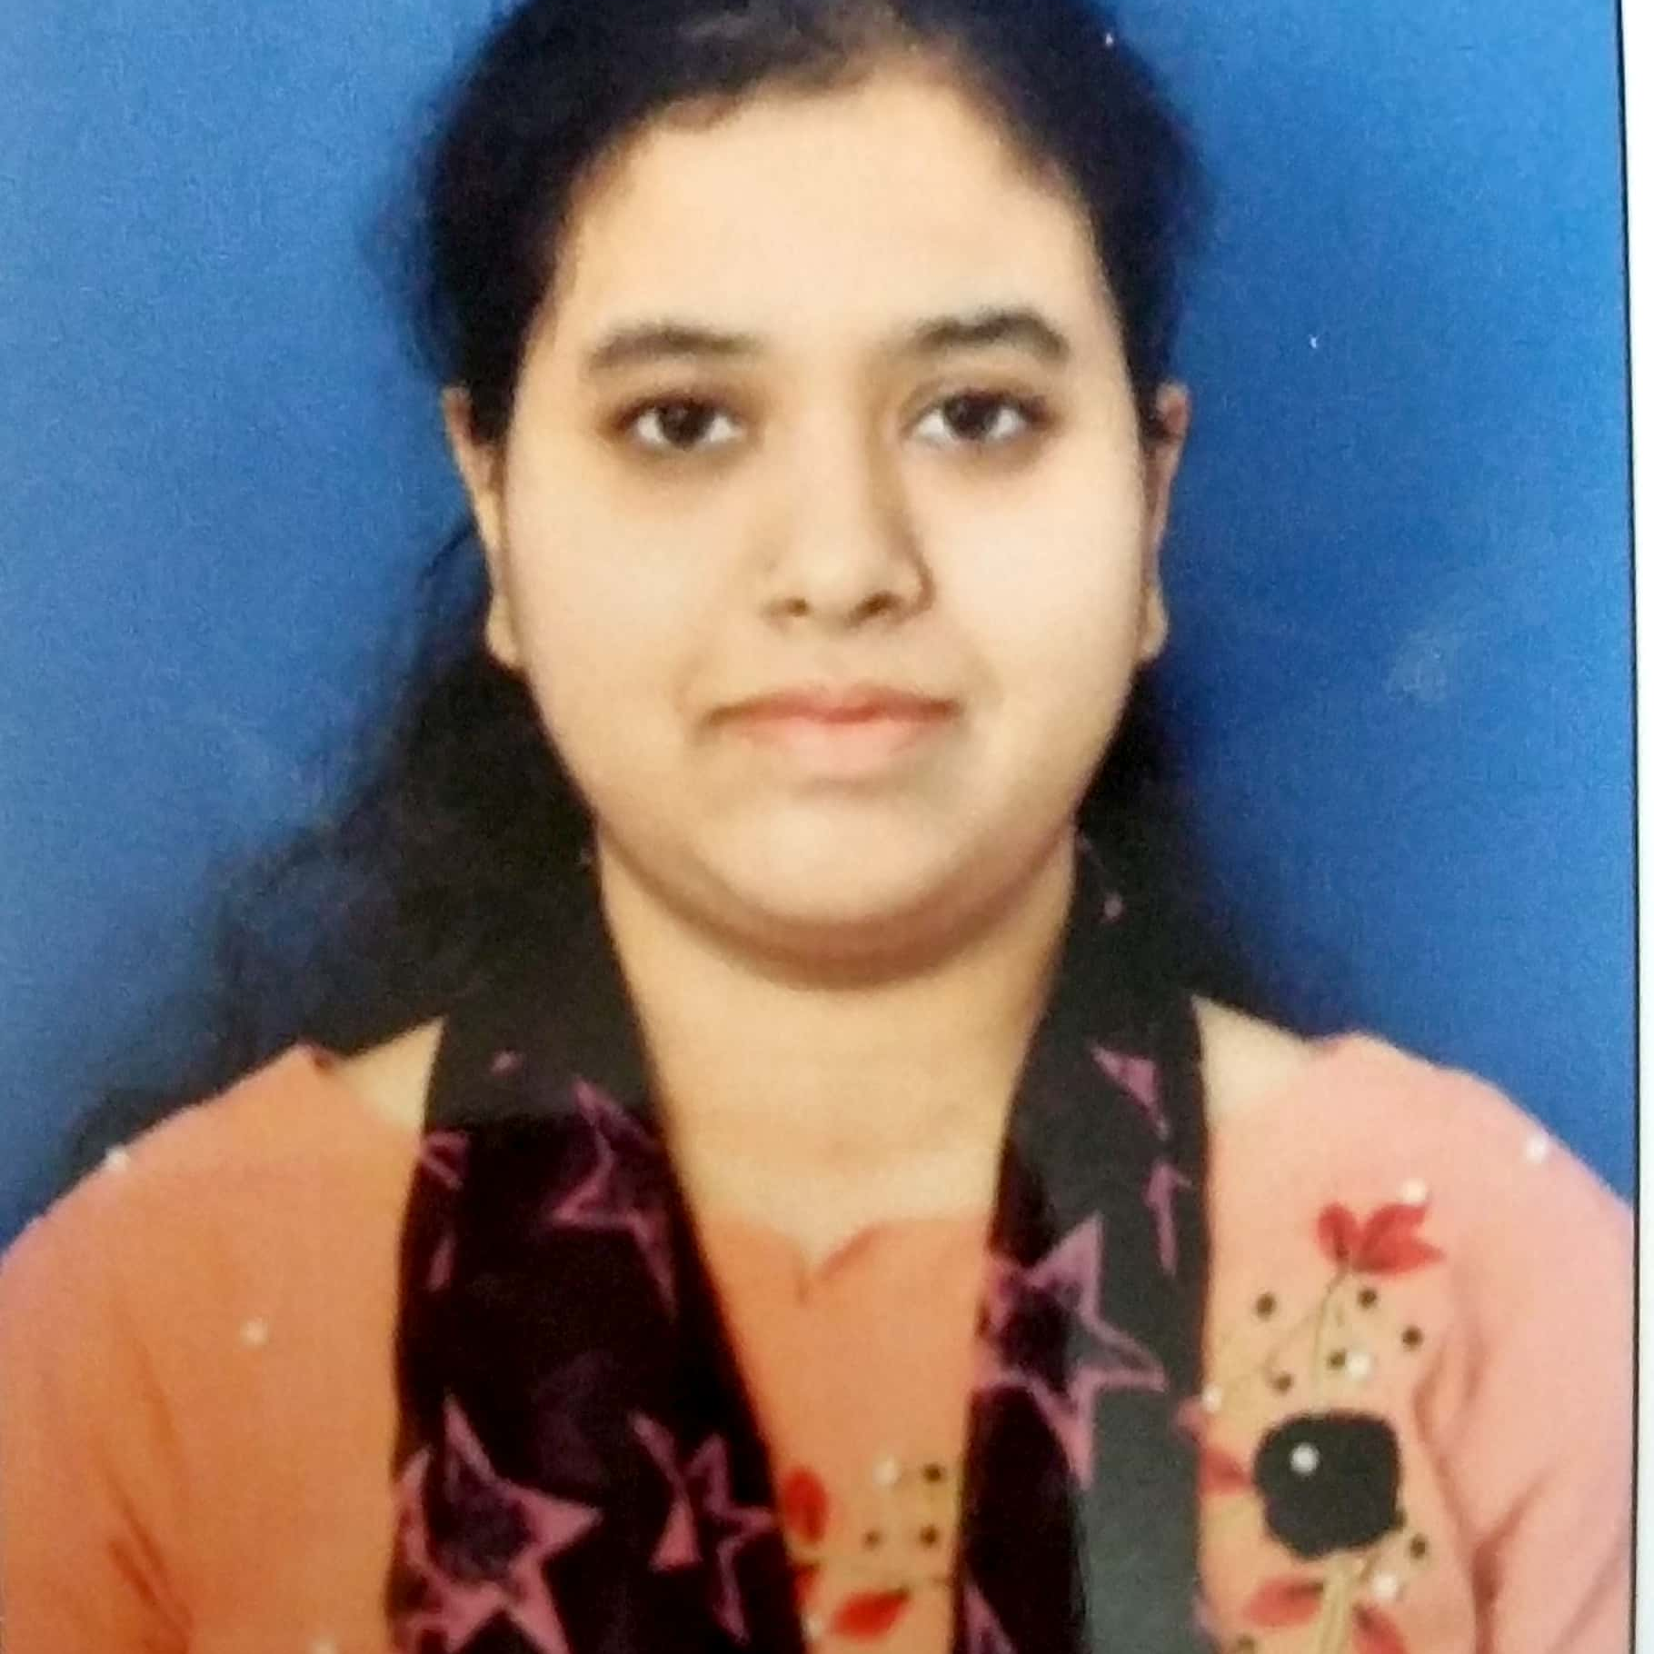
S Shahesthan Anjum
Master of Computer Application
Year:2018-2021
Analyst/Software Engineer
Skills
Bangalore
JAVA | Basics of java, Core Java,, Oops concepts
UI Framework-React Js | Fundamentals components , Type Script, Routing , Working with HTTP in React Js.
React Js | Components, Services, Modules, Routing, Forms & Validation
Database | MongoDB basics , SQL ,Redis.
UI Tech | HTML 5 & CSS 3,JavaScript, Optimized UI Designed
Tools | Spring Tool ,Visual Studio 2019, Visual Studio code, Swagger, Postman
Add On skills | Communications, Team management. Peer learning
s-shahesthan.anjum@capgemini.com
+91 9740722765
A4
Proficient in JAVA and OOPs concepts.
Hands on experience in developing web pages using HTML5, CSS3, Object Oriented Programming.
Hands on experience in creating Web Application with Spring Boot and React Js.
Practical understanding of rendering REST API.
Implemented Web API and React Js in case study and up skilling this knowledge continuously.
Uber Clone
Working on end to end case study make Uber clone Application along with Eureka, Swagger and React Js used for user interface.
Assignments
Native Sql in Spring boot and Spring Profiles.
AWS Services
Completed AWS Certified Cloud Practitioner
Java Full Stack Developer in Degreed Platform
Completed this course with optimal Knowledge of MVC ,Web API , RESTful services , Components.

